Slide 1
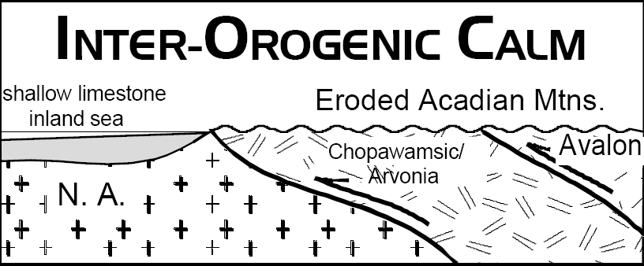
Notes:
Just like the Taconic, the Acadian Orogeny was over when the mountains had worn down and the foreland basins had filled with sediment.

Slide 2
The Mississippian Orogenic Calm Mississippian; 350 - 320 mya
Notes:
Another period of orogenic calm followed. With the influx of clastic sediment for the Acadian Mountains finished, carbonates flourished in the clear, shallow Kaskaskia epicontinental sea.

Slide 3
Notes:
For a time, the Mississippian reef builders are blissfully unaware of the tectonic catastrophe that will soon cause 87% of all fossil families to go extinct.

Slide 4
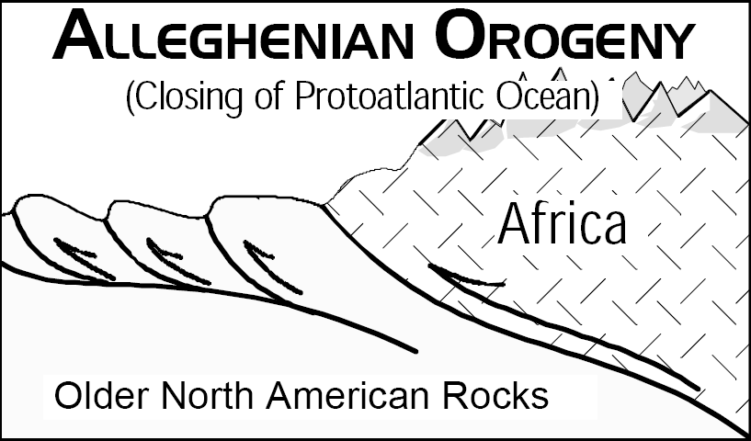
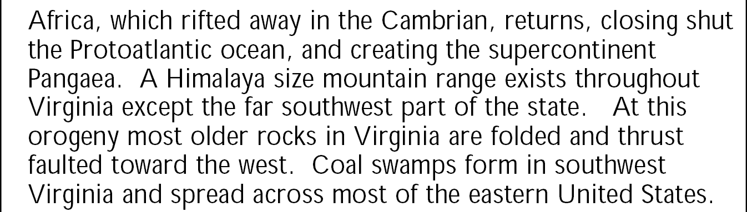
Notes:
The carbonate salad days will end with the climactic orogeny of the Appalachian saga – the mighty Alleghenian! This was the last major orogenic event to affect the Mid-Atlantic region.

Slide 5
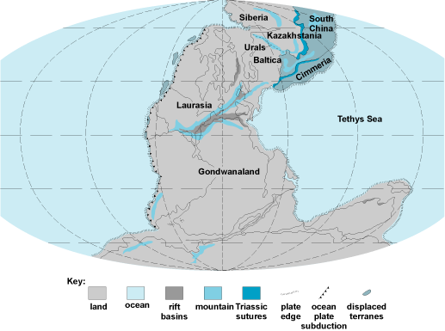
Alleghenian
Hercynian
Mauritanide
Ouachita
Notes:
The orogeny occurred when northwest Africa, (part of the supercontinent Gondwana) collided with the eastern seaboard of North America closing the Proto-Atlantic and Rheic oceans. The collision resulted in several associated orogenies; the Mauritanide (the complementary orogeny on Africa opposite the Alleghenian), the Ouachita (South America striking the Gulf Coast region), and the Hercynian (Gondwana colliding with southern Europe). All of these orogenies sutured together the supercontinent Pangaea.

Slide 6
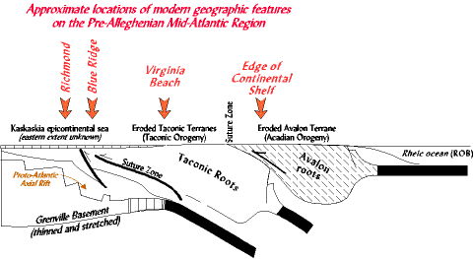
Foreland basin clastic wedges
Epicontinental carbonates
DCM sediments
Notes:
To understand how the Alleghenian orogeny affected the central Appalachians it’s helpful to review what the region was like just prior to the Alleghenian. To the east, the eroded stumps of the prior Taconic and Acadian orogenies lay bare and exposed at the surface. To the west, their respective foreland basins lay completely filled with mid-to-late Paleozoic clastic wedges and oblivious epicontinental carbonates – all of which cover early Paleozoic DCM sediments which in turn lay above the rifted Grenville basement rocks. Despite the two major collision orogenies, the pre-Alleghenian sedimentary rocks were left surprisingly unscathed. Almost no recognizable internal folding or faulting existed prior to the Alleghenian.

Slide 7
The Late Paleozoic Alleghenian Orogeny Mississippian, Pennsylvanian, and Permian; 320 my to 250 my
Notes:
Unlike the two previous orogenies, the mighty Alleghenian orogeny caused intense folding and thrust faulting of all pre-Alleghenian rocks in the region and built a mountain range that was probably Himalayan in scale. Virtually all of the landforms, physiographic provinces, structures in road cuts, etc. seen today in the central Appalachians reflect this event. In the Alleghenian orogeny, the African portion of Gondwana became a hinterland - meaning it was thrust up and over the North American edge. The weight of Africa shoved the North American rocks down deep in the earth and metamorphosed them. None of Africa remains here, by the way. All of it was removed by erosion and transported westward as sediments into the foreland basins. The Alleghenian foreland basin developed farther west through Kentucky, West Virginia, western Pennsylvania, Ohio, and beyond.

Slide 8
Great Smokey
Shenandoah
Acadia
Closing
Collision Orogeny
Peneplanation
Rifting
DCM Sedimentation
Subduction Orogeny
+/- Terrane Accretion
Collision Orogeny
Opening
Closing
Notes:
Although all three Appalachian parks were affected by the Alleghenian orogeny, Great Smokey National Park shows off the Alleghenian structures best.

Slide 9
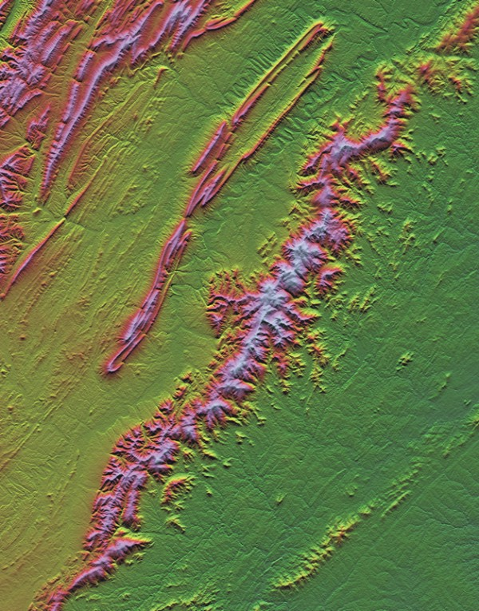
Blue Ridge
Notes:
The Alleghenian thrust the hard Grenville crust up to form the Blue Ridge province, but the old crystalline rocks in the Blue Ridge lack the layering that really shows-off the Alleghenian folds. Such folding is best seen in the compressed sediments of the Valley and Ridge province.

Slide 10
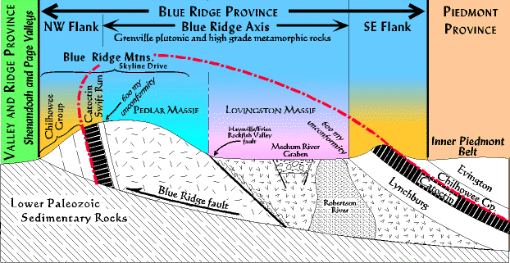
Notes:
…but although the overturned anticline of Shenandoah was folded by the Alleghenian, the old crystalline rocks in the Blue Ridge lack the layering that really shows-off the Alleghenian folds.

Slide 11
Valley and Ridge
Blue Ridge
Notes:
Such folding is best seen in the compressed sediments of the Valley and Ridge province, where the ridges are formed of the more resistant sedimentary rocks …

Slide 12
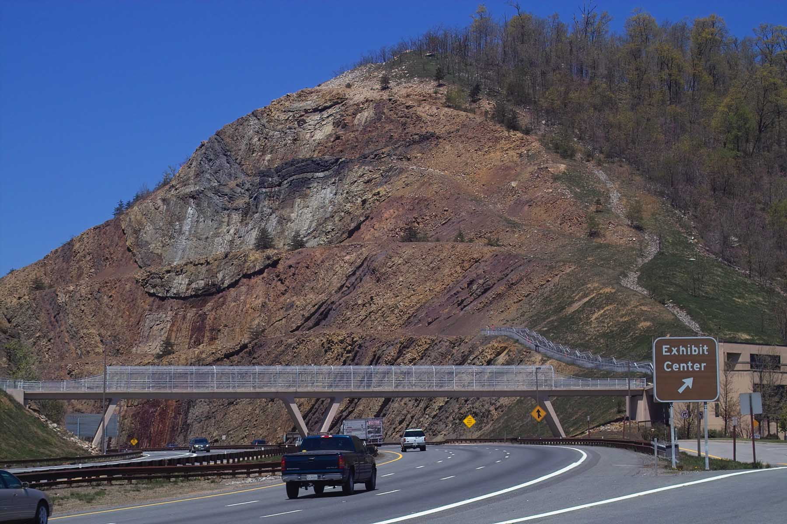
Notes:
… like at Sideling Hill, a beautiful syncline exposed in a road cut along I-68, about 60 miles NNW of Shenandoah National Park. Similar folds were produced throughout the Valley and Ridge Province by the Alleghenian Orogeny, but nowhere are they as beautifully exposed as they are here.

Slide 13
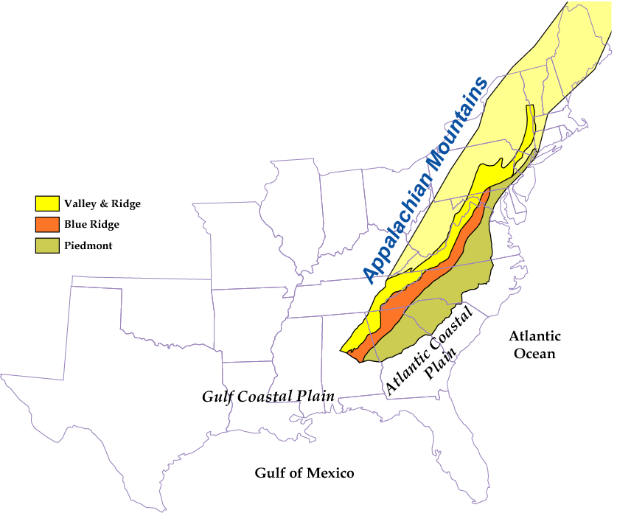
ANCIENT COLLISIONAL MOUNTAIN RANGE
Acadia
Shenandoah
Great Smokey
Parks and Plates
©2005 Robert J. Lillie
Notes:
Nonetheless, because Great Smokey National Park includes a portion of the Valley and Ridge Province, similar structures do occur there.

Slide 14
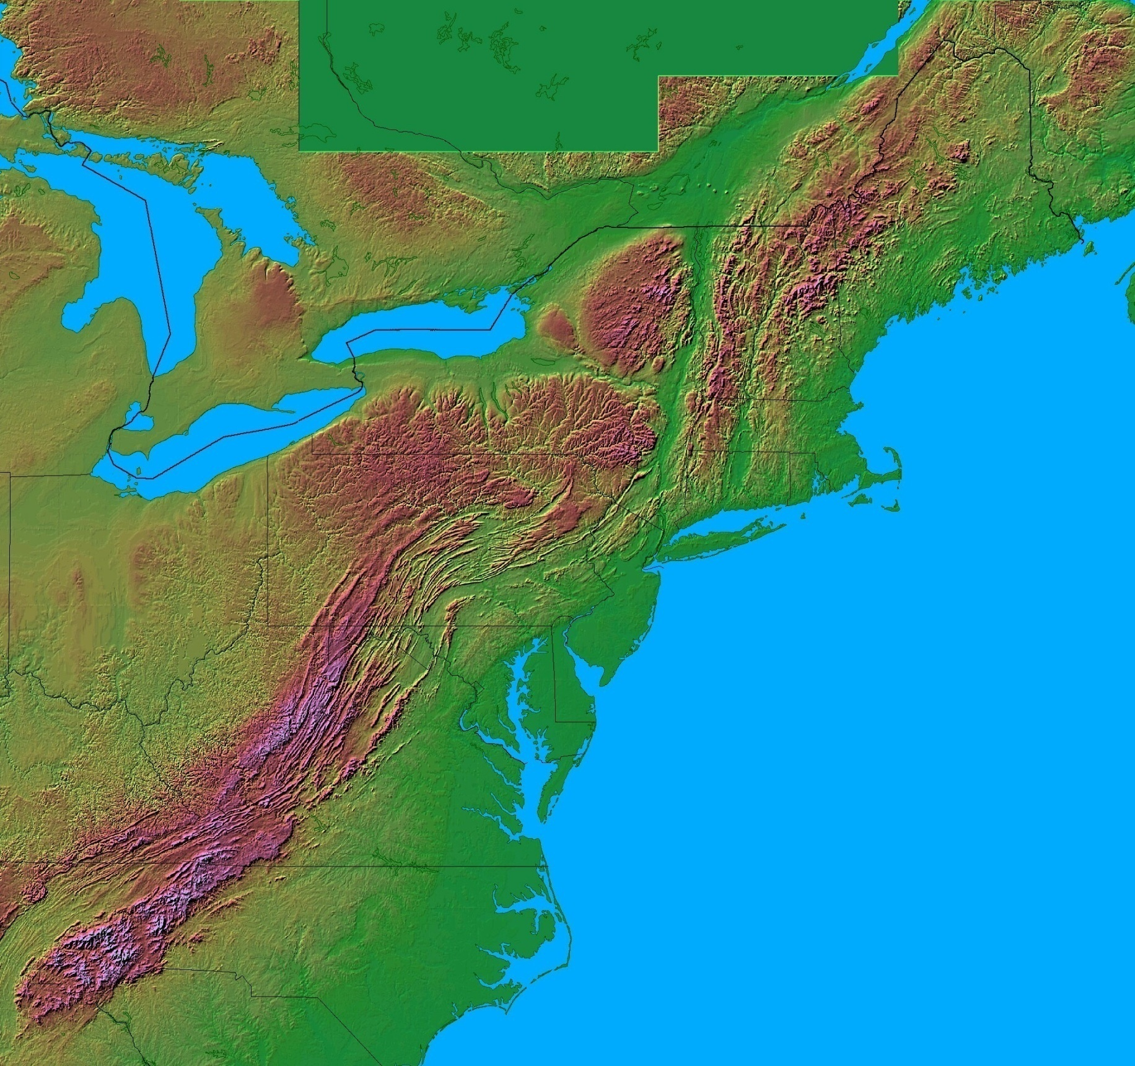
Acadia
Shenandoah
Appalachian National Parks
Great Smokey
Notes:
In fact, the Alleghenian Orogeny was especially intense in the Great Smokey’s, …

Slide 15
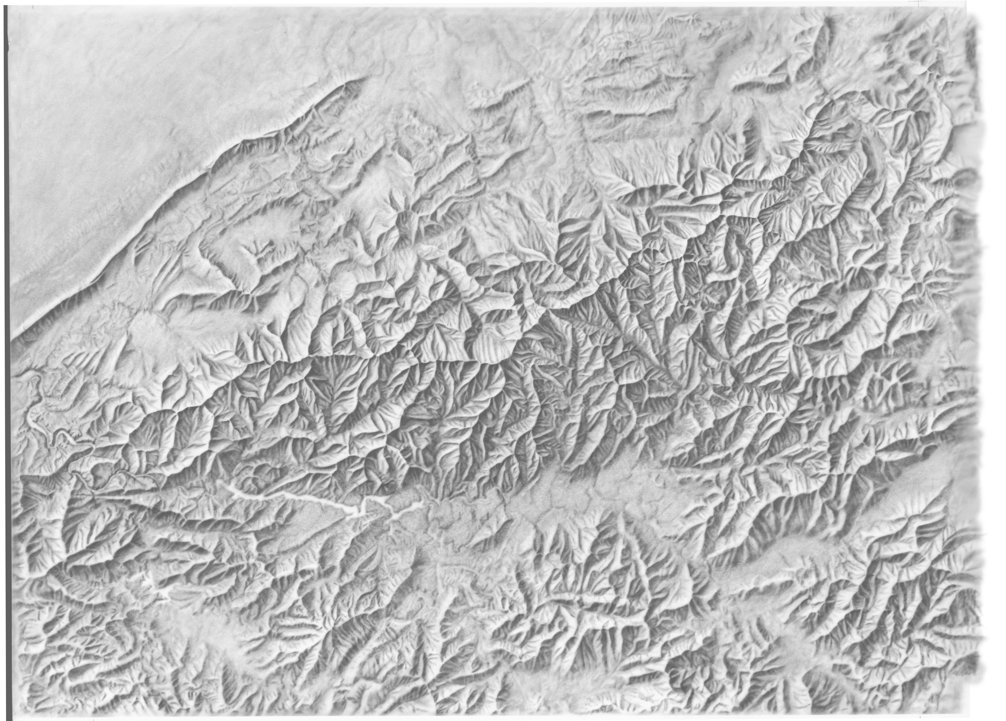
Notes:
… a fact witnessed by the much greater width of the Appalachians in the Smokey’s, …

Slide 16
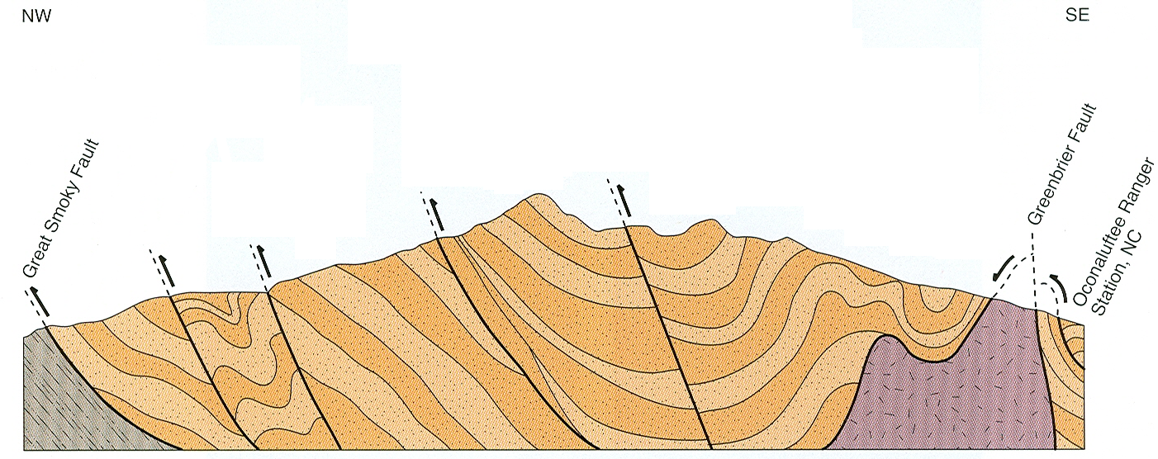
Thrust faults moved Precambrian rocks ~150 miles westward
Metamorphosed basalt
Paleozoic sedimentary rocks
Gneiss and granite
More intense deformation at Great Smoky than Shenandoah
Precambrian sedimentary and metamorphic rocks
Notes:
… along with tighter folds and more closely spaced thrust faults compared to Shenandoah. This is not to downplay the affects Alleghenian Orogeny in Shenandoah, where not only did the orogeny form the overturned anticline, but it also thrust the Grenville basement some 150 miles westward. It’s just that the orogeny was even more intense in the Great Smoky Mountains where displacement along the Great Smoky thrust fault has been estimated by some accounts to be 200 to 300 miles!

Slide 17
Notes:
With that kind of displacement the rocks along the Great Smokies Fault are obviously going to become highly disturbed – a fact underscored by the “outcrop from hell” description someone gave this road cut.

Slide 18
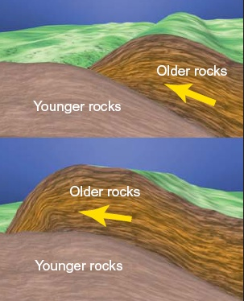
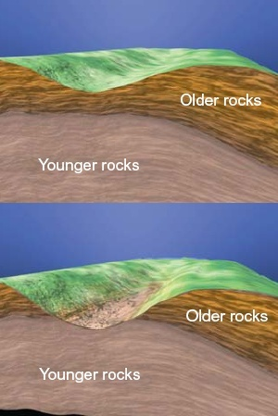
Development of a Thrust Window
Notes:
One of the more intriguing features often formed in association with thrust faults is a “thrust window”. Thrust faults always thrust older rocks up and over younger rocks along relatively low-angle reverse faults. If a portion of the overlying older rock is removed by erosion such that the underlying younger rock is exposed, the area of exposed younger rocks is called a thrust window.

Slide 19
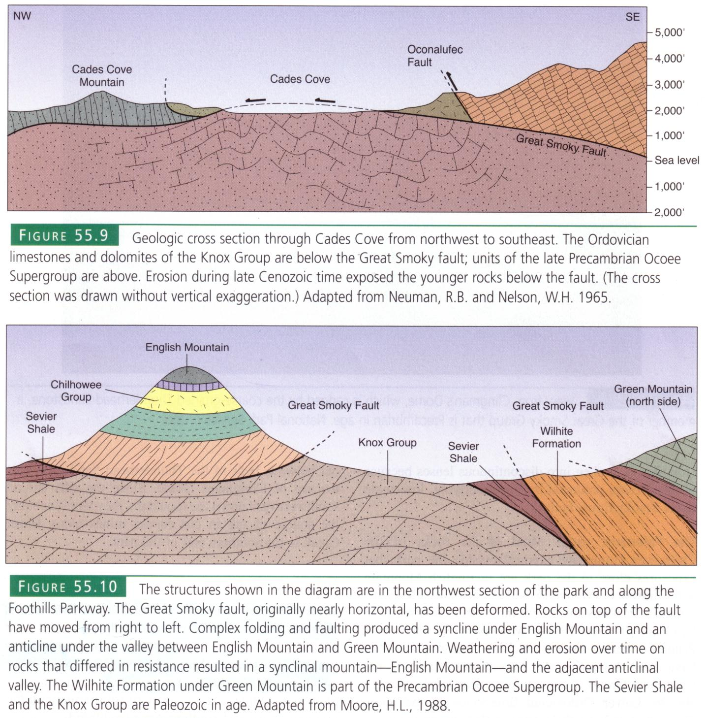
Notes:
Cades Cove is one of many such thrust windows in the Valley and Ridge province. Younger (Ordovician) DCM carbonates are exposed in the window which is surrounded by mountains of older (late Proterozoic) rocks which lie above the Great Smoky Thrust Fault.

Slide 20
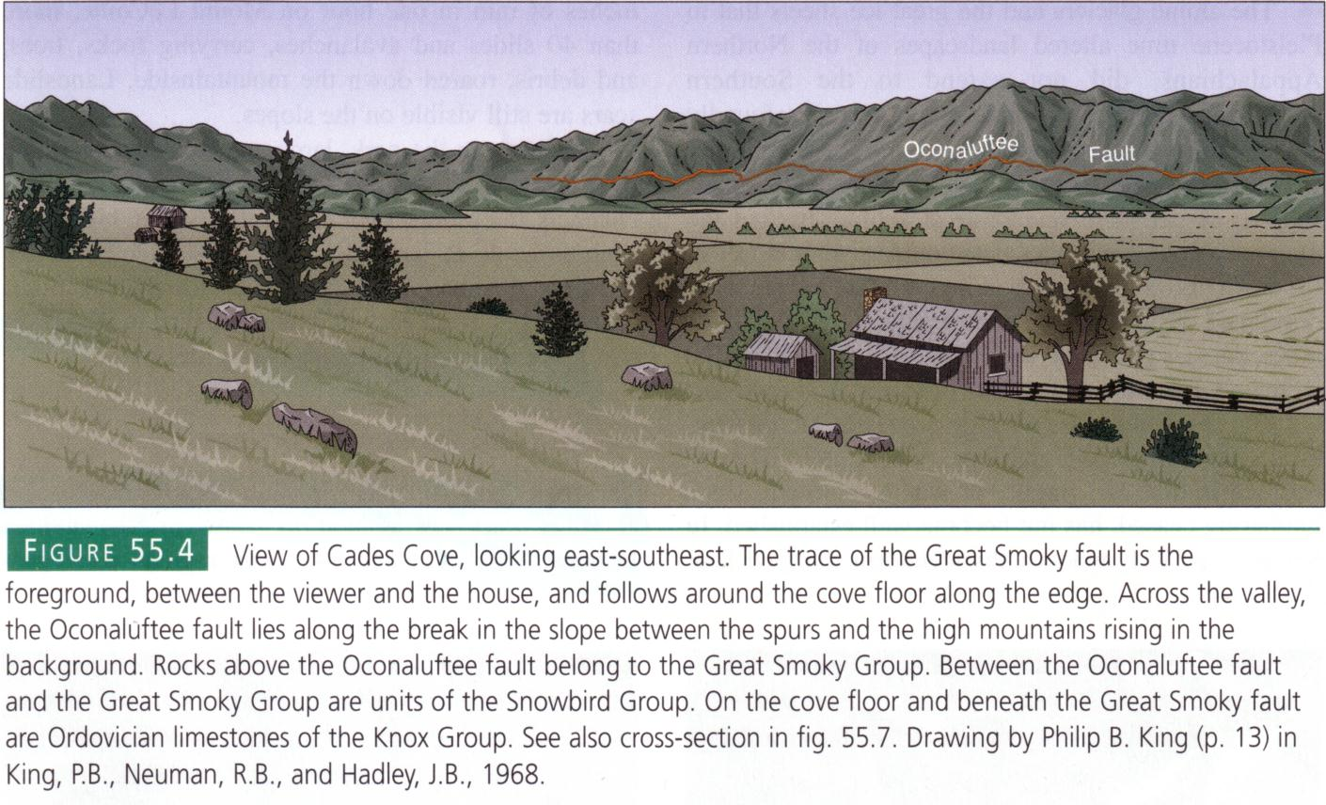
Notes:
Pioneers found that the carbonates in Cades Cove were far more productive than the poorer mountain soils and so the valley was settled.

Slide 21
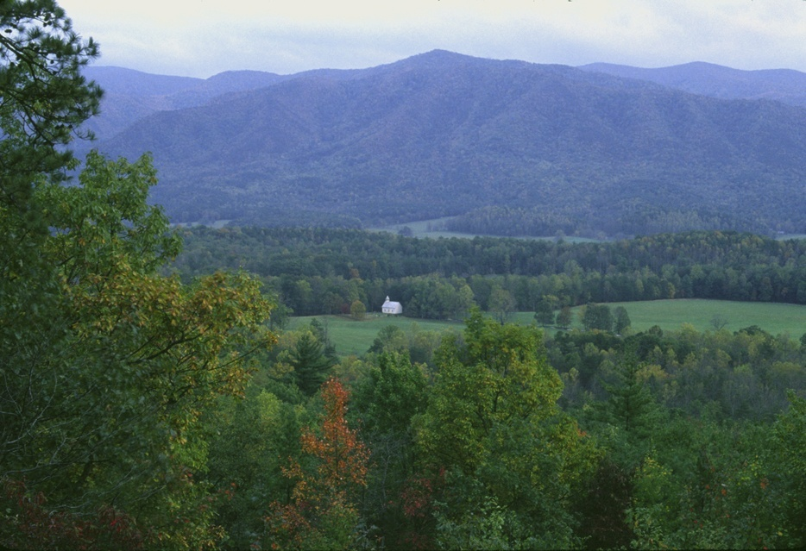
Cades Cove
Notes:
The pattern of settlement in areas underlain by carbonate rocks was repeated many, many times throughout the Valley and Ridge Province - a great example of how geology influences human behavior.

Slide 22
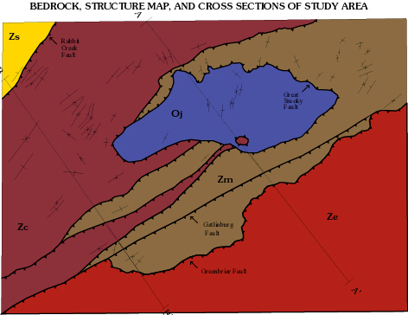
Notes:
On this bedrock and structure map of Cades Cove in the Great Smoky Mountains National Park you can see the exposed carbonates in the thrust window in blue surrounded by various late Proterozoic rocks. On geologic maps thrust faults are always shown with a saw-toothed pattern and the teeth always point towards the rocks that lay above the fault.

Slide 23
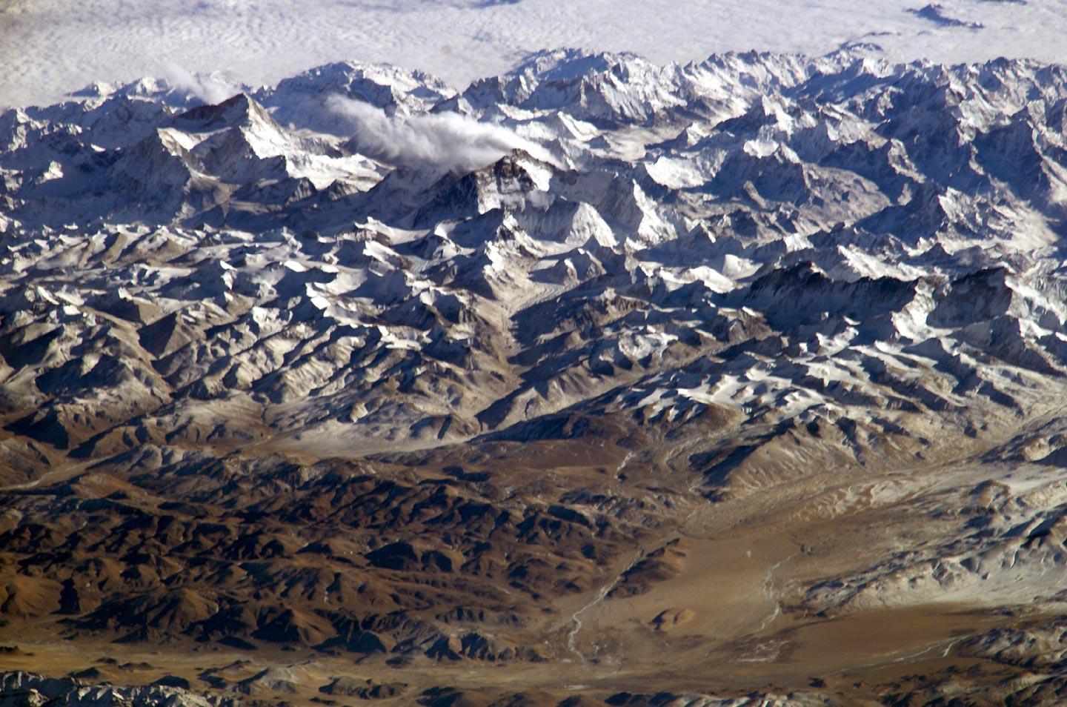
Mongolia
Nepal
Mount Everest
India
Notes:
If we place a similar symbol at the base of the Himalayas in India, the teeth would point away from India but toward Nepal and Mongolia which are thrust on top of India.

Slide 24
Africa
“Allegheny Mountains”
North America
Notes:
The Himalayas provide a modern analogue to the mountains built by the Late Paleozoic Alleghenian orogeny - the bulk of which would have been made of Africa, thrusting over the North American craton. One of the main differences in this uniformitarianism-based thought experiment is that relative sea level was higher during the Alleghenian orogeny and, so, much of North America was under water (the Absaroka epicontinental sea). During the climax of the Alleghenian orogeny (during the Late Pennsylvanian) the sediments eroding from the Allegheny mountains poured into the adjacent sea, building deltas and the coal swamps …

Slide 25
Notes:
… which produced the vast quantities of Appalachian coal mined today.

Slide 26
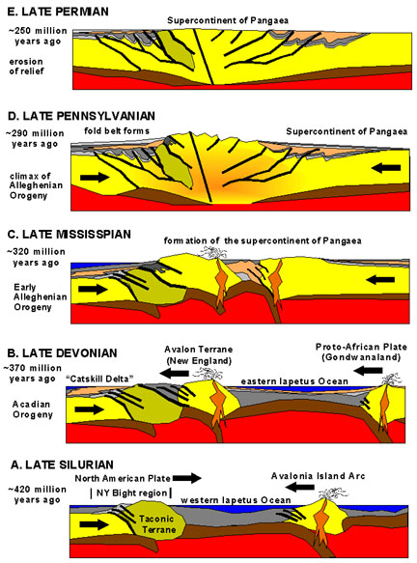
Alleghenian Orogeny
Notes:
The Alleghenian lasted for a long, long time. It started in the Late Mississippian and it wasn’t over until the Late Permian when the mountains had completely worn down and the foreland basins had been filled.

Slide 27
Great Smokey
Shenandoah
Acadia
Closing
Collision Orogeny
Peneplanation
Rifting
DCM Sedimentation
Subduction Orogeny
+/- Terrane Accretion
Collision Orogeny
Peneplanation
Opening
Closing
Notes:
Thus the supercontinent cycle that began with the Late Proterozoic rifting of Pannotia (or Rodinia if you prefer) ends with the peneplanation of Pangaea some 320 million years later. All three of our Appalachian Parks were peneplaned, but none display particularly good records of the event. The massive supercontinent of Pangaea lasted about 50 million years, …

Slide 28
Great Smokey
Shenandoah
Acadia
Closing
Collision Orogeny
Peneplanation
Rifting
DCM Sedimentation
Subduction Orogeny
+/- Terrane Accretion
Collision Orogeny
Peneplanation
Rifting
Opening
Closing
Opening
Notes:
… until, like all supercontinents, it succumbs to the tensional forces associated with a newly initiated hot spot (mantle plume) and undergoes rifting about 200 million years ago.

Slide 29
Notes:
Rift valleys opened along the entire length of the peneplaned Alleghenian mountains during the Late Triassic to Lower Jurassic.

Slide 30
Great Smokey
Shenandoah
Acadia
Closing
Collision Orogeny
Peneplanation
Rifting
DCM Sedimentation
Subduction Orogeny
+/- Terrane Accretion
Collision Orogeny
Peneplanation
Rifting
Opening
Closing
Opening
Notes:
… Although none of our three parks actually preserve any of the rift valley sediments, Shenandoah …

Slide 31
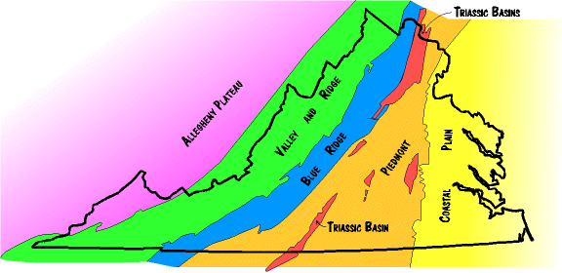
Triassic Basins
Notes:
... lies very close to one of the Triassic rift basins, which are mostly located in the Piedmont province. None of these rift basins extended to the point where oceanic crust was produced. That boundary lay well to the east of the current Atlantic shoreline in North America.

Slide 32
Rifting of Pangaea: Initiation of the Atlantic Ocean (Triassic and Lower Jurassic; 230 my to 175 my
Notes:
Thus rifting was not symmetrical. Like a lopsided divorce settlement, the union and subsequent separation of North America and Africa left North America with all the marriage-accumulated wealth – in this case, the terranes accreted by the Taconic and Acadian orogenies.

Slide 33
Rifting of Pangaea: Initiation of the Atlantic Ocean (Triassic and Lower Jurassic; 230 my to 175 my
Tac
Ava
Notes:
Or if you prefer a different analogy, North America got custody of the children – Tac and Avalonia. Poor Africa was not only left alone, but because it was thrust over North America during the Alleghenian, it bore the cost of peneplanation far greater than did North America and thus left the marriage with a sizeable chunk of its pre-marriage real estate missing.

Slide 34
The Mesozoic and Cenozoic Divergent Cont. Margin Upper Jurassic, Cretaceous, and Cenozoic; 175 my - present
Axial Rift
Notes:
North America even got the divorce records – the axial rift!

Slide 35
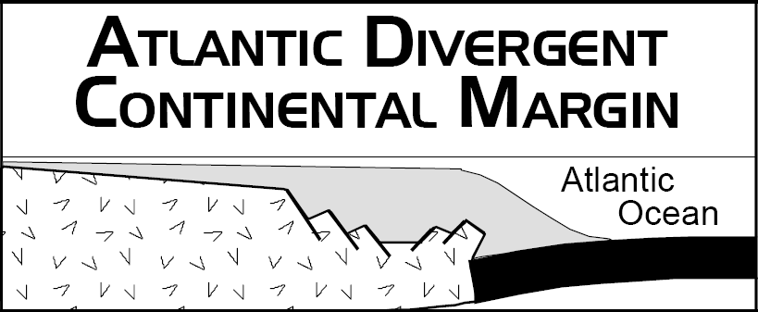
Notes:
But life goes on after divorce and both divergent continental margins got on with the process of rebuilding. The old rifts are now completely covered by thick DCM sediments on the continental shelf and coastal plain. One day in the distant geologic future those sediments may be thrust upwards into majestic, collision-built mountains should North America and Africa rekindle their tectonic attractions and reunite. Although they’ve done it twice before, there’s no guarantee that North America will reunite with Africa. However, if the Wilson Cycle is true to its promise, both continents will remarry, just not necessarily to one another. They may find different super-continental partners once the Atlantic ocean floor which separates them has fully sunk back into the mantle. No matter who they hook up with, subduction always leads to orogeny.

Slide 36
Great Smokey
Shenandoah
Acadia
Closing
Collision Orogeny
Peneplanation
Rifting
DCM Sedimentation
Subduction Orogeny
+/- Terrane Accretion
Collision Orogeny
Peneplanation
Rifting
DCM Sedimentation
Opening
Closing
Opening
Notes:
But I’m getting ahead of the story. It turns out that more than just DCM sedimentation happened as the Atlantic widened.

Slide 37
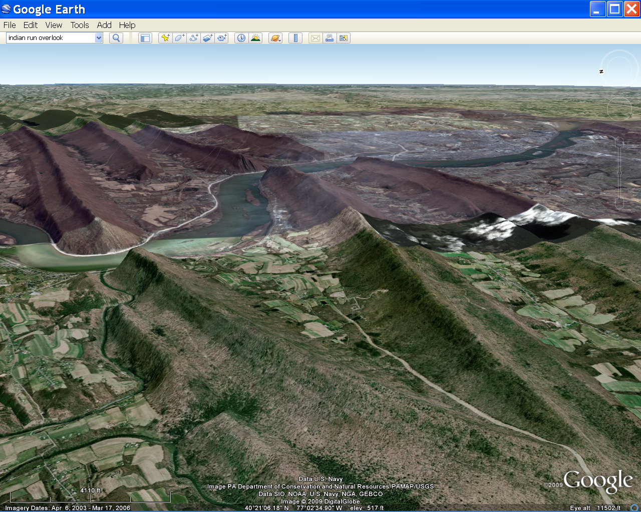
Harrisburg, Pa.
Susquehanna River
(Vertical Exaggeration = 2X)
Notes:
That the Appalachian landscape has not been completely stable following the last period of peneplanation is evident in the distinctive pattern of long parallel ridges of nearly the same elevation separated by narrow valleys, and the narrow, steep sided “water gaps” that slash across those ridges. A little thought shows that the rivers flowing through the water gaps could not have cut those gaps after the mountains formed. To do so the water would have to flow uphill - and then erode down. The conclusion is that the rivers existed before the mountains.

Slide 38
near equal elevations
Notes:
Similarly, the near equal elevations of all the ridges seems to indicate that rocks underlying all the ridges were at one time eroded down to the same elevation, and that they have all been lifted up at the same time. Both of these lines of evidence lead to the conclusion that sometime in the Cretaceous or Cenozoic all of Appalachia had been eroded down …

Slide 39
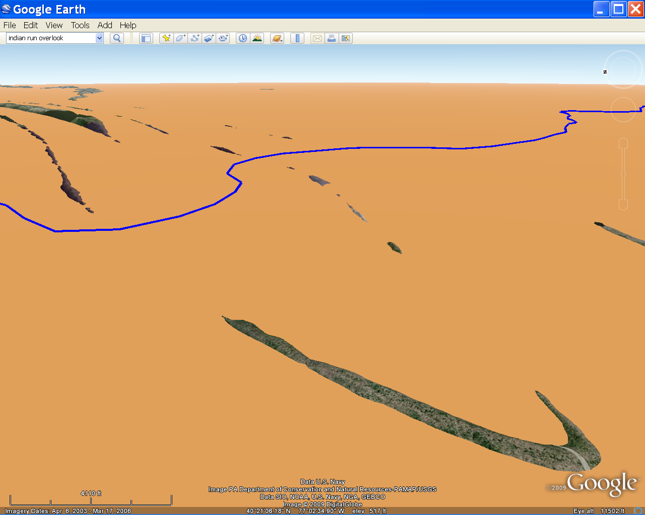
Former peneplane surface
Notes:
… to another peneplain, flat all the way down to sea level, crossed by rivers draining the continent to the west.

Slide 40
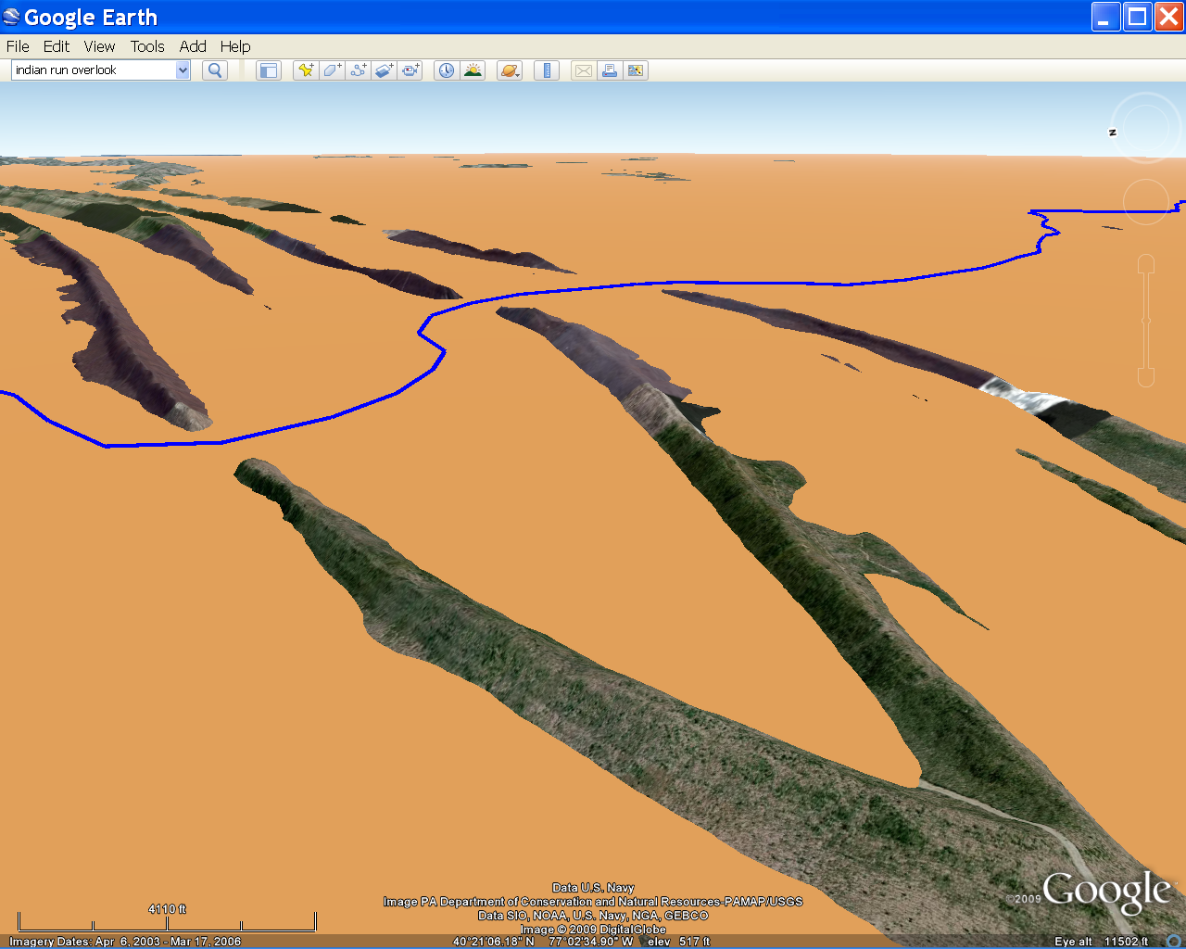
Notes:
Furthermore, all this land then underwent gentle uplift (rejuvenation) allowing the streams and rivers to begin to erode and cut their way back down.

Slide 41
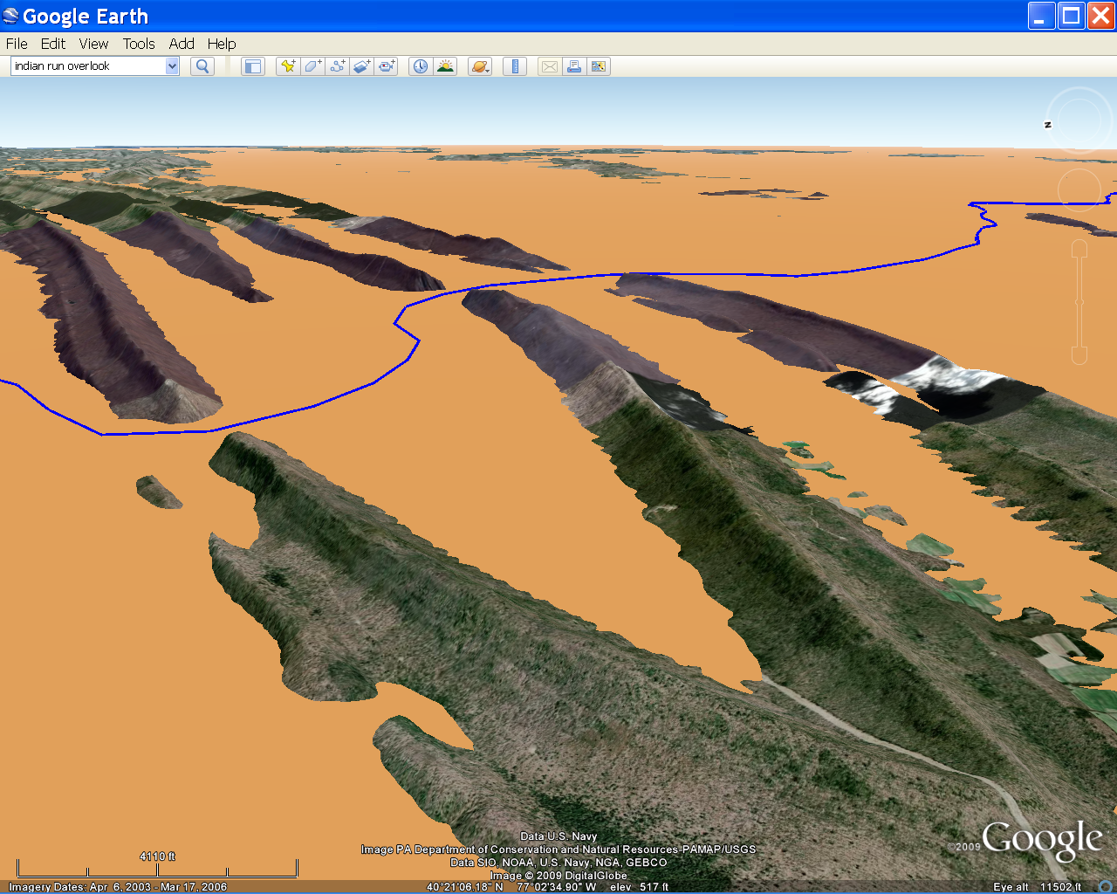
hard rocks
hard rocks
Notes:
The ridges are the hard rocks resisting erosion …

Slide 42
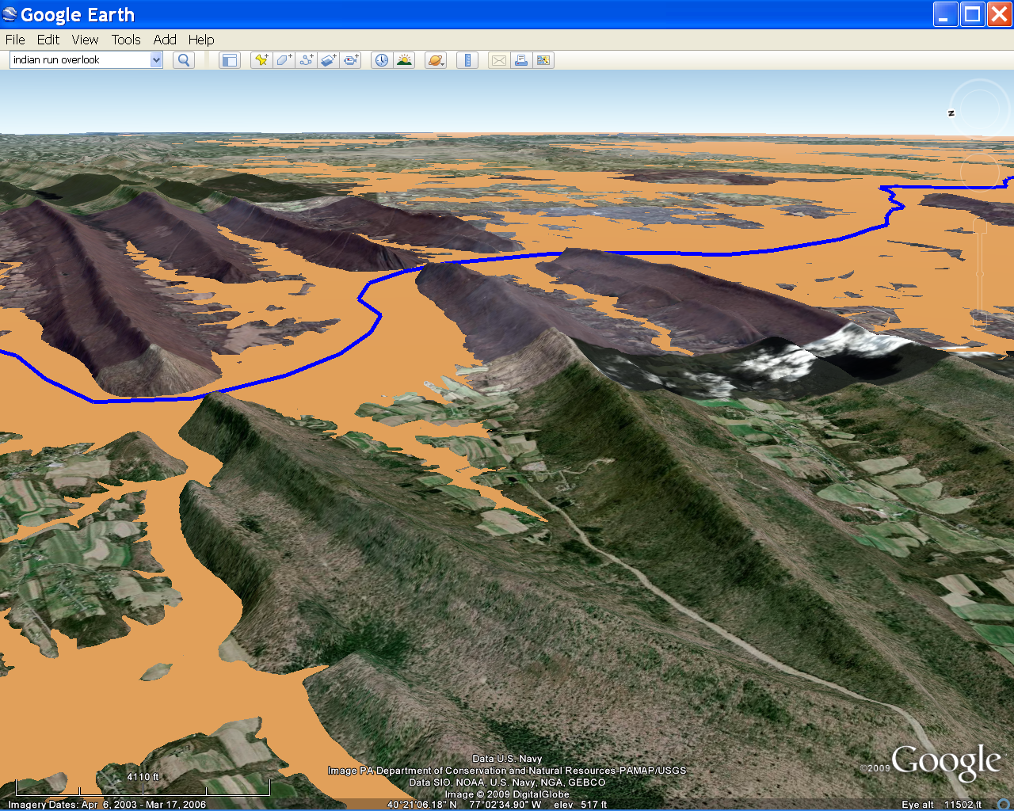
soft rocks
Notes:
and the valleys softer rock eroding away.

Slide 43
Notes:
The ridges run parallel to each other because they were all folded and faulted the same way during the Alleghenian orogeny.

Slide 44
Notes:
Thus, what we are seeing are the final stages of uplift of the Alleghenian mountains, as the east coast of North America settles into greater and greater tectonic stability. Mechanisms hypothesized to account for this period of rejuvenation include continuous buoyant uplift of thickened crust and Tertiary to recent arching - perhaps associated with mantle migration away from the region depressed by the loading of DCM sediments.

Slide 45
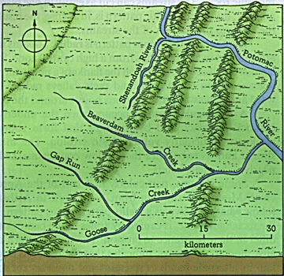
Water Gaps
Notes:
At any rate one of the interesting consequences of rejuvenation in the Valley and Ridge province is stream capture. As rejuvenation uplifted the land, streams down cut into their valleys and extended their courses by headward erosion. This process happened faster for larger streams like the Shenandoah and Potomac Rivers than it did for smaller streams like Beaverdam, Gap Run and Goose Creeks.

Slide 46
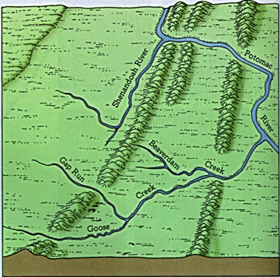
Notes:
Eventually headward erosion of the Shenandoah River (following the trend of more easily eroded rock) intersected the headwaters of Beaverdam Creek. Since the larger Shenandoah/Potomac River system had eroded its valley to a lower elevation than did the smaller creeks, all portions of Beaverdam Creek that where higher than the Shenandoah River at the intersection point drained into the Shenandoah. The added discharge only accelerated the down cutting and headward erosion of the Shenandoah River …

Slide 47
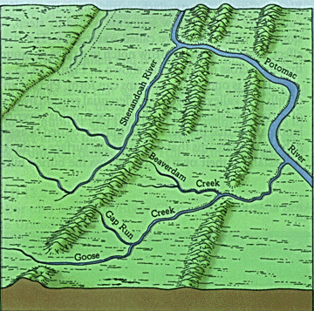
Notes:
… such that it went on to capture the headwaters of Gap Run Creek …

Slide 48
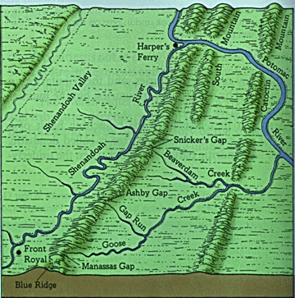
Wind Gaps
Notes:
… and Goose Creek as well. With their headwaters captured, the three creeks had far less discharge and could not muster enough down cutting to keep place with the uplift of the ridges. Their old water gaps through the ridges where eventually abandoned and replaced with “wind gaps” through which now only wind flows.

Slide 49
Great Smokey
Shenandoah
Acadia
Closing
Collision Orogeny
Peneplanation
Rifting
DCM Sedimentation
Subduction Orogeny
+/- Terrane Accretion
Collision Orogeny
Peneplanation
Rifting
DCM Sedimentation
Opening
Closing
Opening
Notes:
Well we have just a couple of finishing touches on the whole Appalachian saga to go over and we’re done! By virtue of its northerly and coastal positioning, Acadia National Park will have the honors of telling the last part of story about Quaternary glacial and coastal processes.

Slide 50
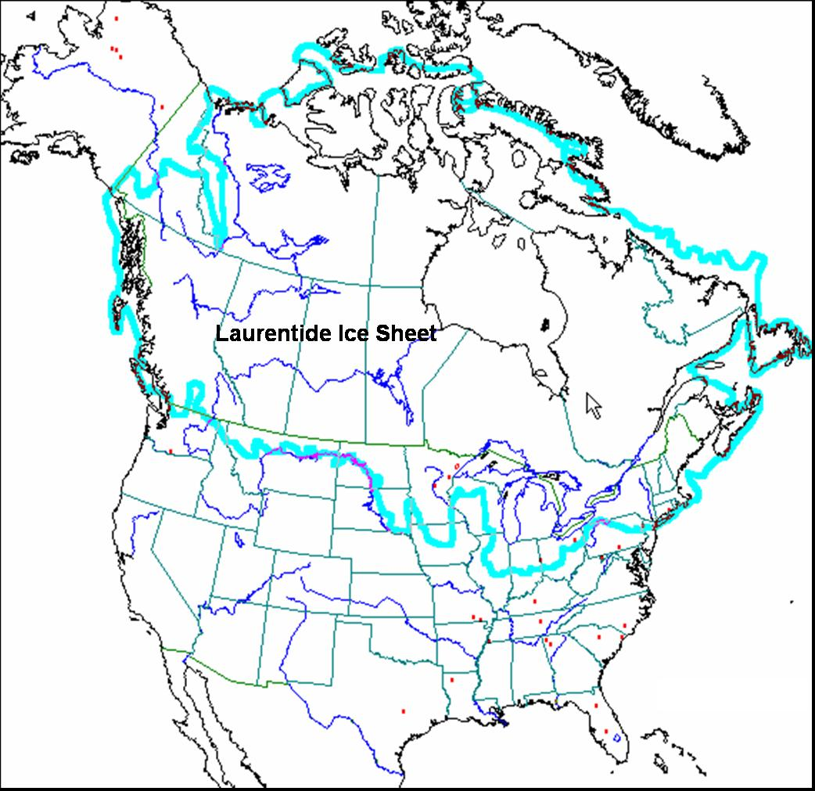
Notes:
The glaciers that eroded Acadia National Park in the Pleistocene were of the continental variety and were part of the vast Laurentide Ice Sheet that advanced and retreated many times across northern North America beginning about 1.7 million years ago.

Slide 51
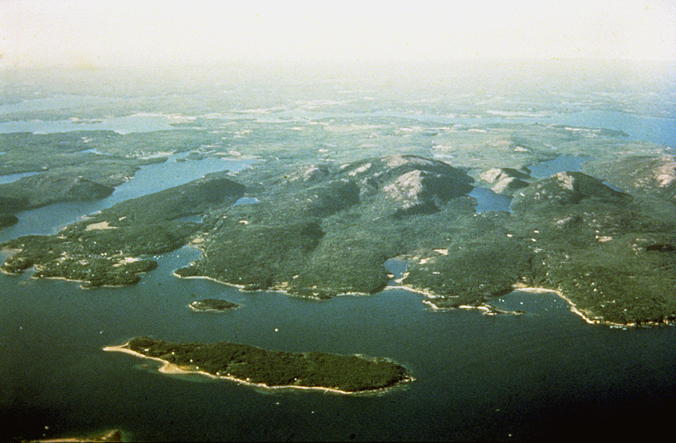
Mount Desert Island – Acadia N.P.
Granite of Cadillac Mountain
Notes:
As is typical of areas affected by continental glaciation, the land was eroded nearly flat except for the most resistant rocks like the Granite of Cadillac Mountain.

Slide 52
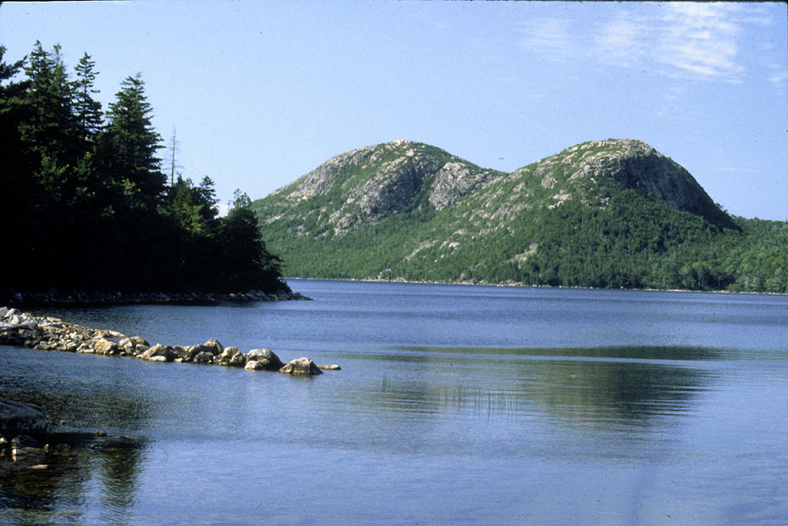
“The Bubbles” (Roches Moutonnees)
Notes:
Most of the rocks that resisted the erosion of the continental ice sheets like “The Bubbles” here were sculpted into Roche Moutonnees. Can you tell which way the glaciers moved?

Slide 53
Notes:
The Porcupine Islands off Bar Harbor are also Roche Moutonnees and nicely show the direction of ice movement from left to right.

Slide 54
Continental lithosphere
Oceanic lithosphere
Oceanic lithosphere
Asthenosphere
Notes:
Glaciation influenced coastal processes by affecting both sea and land levels.

Slide 55
Ice
Continental lithosphere
Oceanic lithosphere
Oceanic lithosphere
Asthenosphere
Notes:
During periods when ice accumulated on land more sea water was evaporated from the ocean than returned via runoff and precipitation so the sea level lowered.

Slide 56
Ice
Oceanic lithosphere
Oceanic lithosphere
Continental lithosphere
Asthenosphere
Notes:
But the weight of the ice pressed the continental lithosphere beneath it into the soft asthenosphere.

Slide 57
Oceanic lithosphere
Continental lithosphere
Oceanic lithosphere
Asthenosphere
Notes:
Now when the ice melts, both sea level and the continental lithosphere rise, but importantly, the continent rises more, because the water added to the ocean from melting ice must be shared with all the world’s oceans and the buoyancy adjustments are confined to only the areas formerly under the weight of ice. Furthermore, a significant amount of ice still exists on places like Greenland and Antarctica, so not all of the glacial water has returned to the ocean. It was during this period that rivers carved valleys down to sea level along former glacial troughs. These valleys where submerged as ice melted in other areas …

Slide 58
Continental lithosphere
Oceanic lithosphere
Oceanic lithosphere
Asthenosphere
Notes:
… causing sea level to rise relative to Acadia because most of the buoyancy adjustments had already taken place. This rise in sea level is still happening in Acadia and explains …

Slide 59
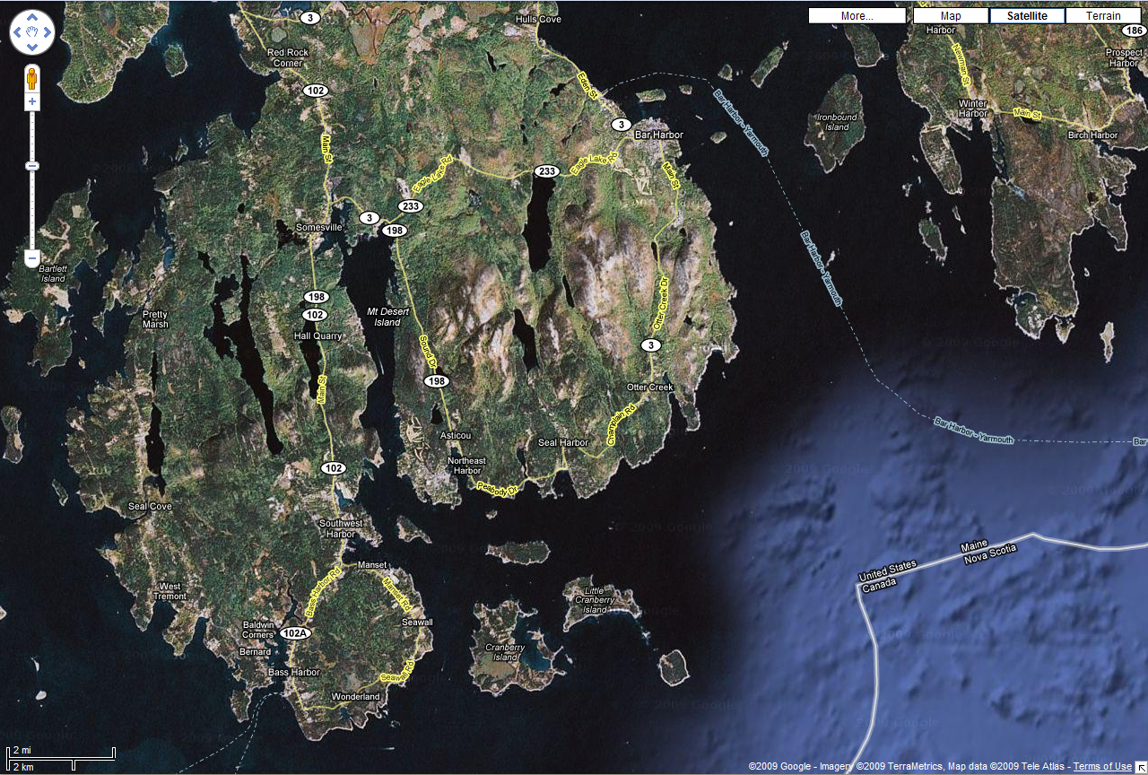
Submerged river valleys
Notes:
… the heavily embayed coast here as former river valleys became submerged.

Slide 60
Glacial troughs
Notes:
Although numerous glacial troughs have been gouged out along areas of softer and/or fractured rocks, …

Slide 61
Somes Sound
Notes:
… only Somes Sound connects with the ocean.

Slide 62
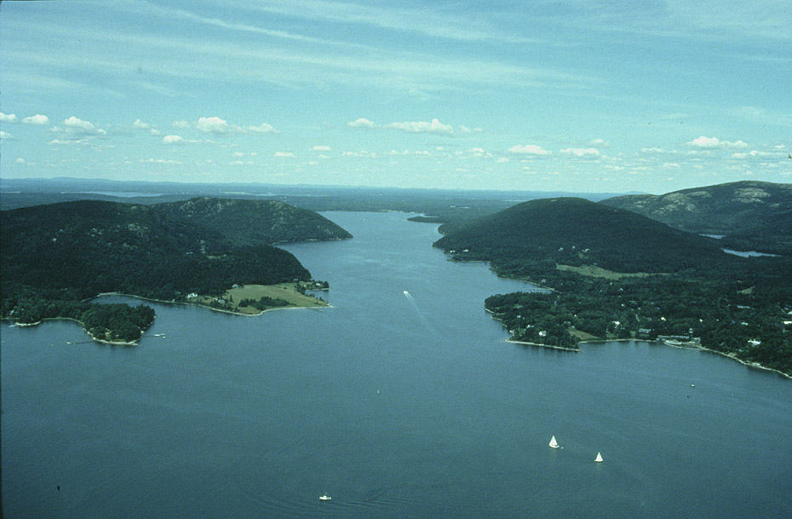
Somes Sound – Only true fjord on E. U.S. seaboard
Notes:
Somes Sound, is therefore a fjord and the only true fjord on the eastern seaboard of the United States. Unlike the numerous embayments that punctuate the coastline which get deeper at their mouths because they were carved by rivers, Somes Sound gets shallower at its mouth. Obviously it could not have been carved by a river. The rising sea level combined with …

Slide 63
Notes:
… heavy surf …

Slide 64
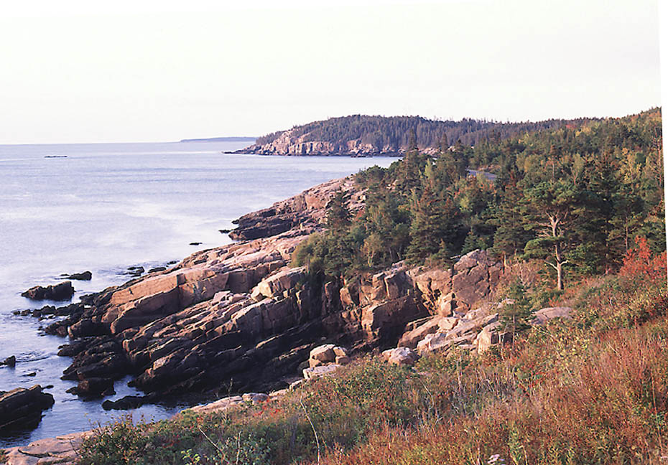
Notes:
… and durable granite have sculpted one of the most beautiful coastlines in America.

Slide 65
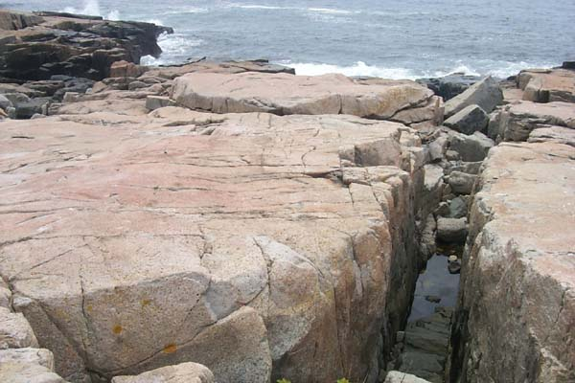
Notes:
The granite is so durable that virtually all coastal erosion is confined to softer areas such as where joints or dikes cut the granite.

Slide 66
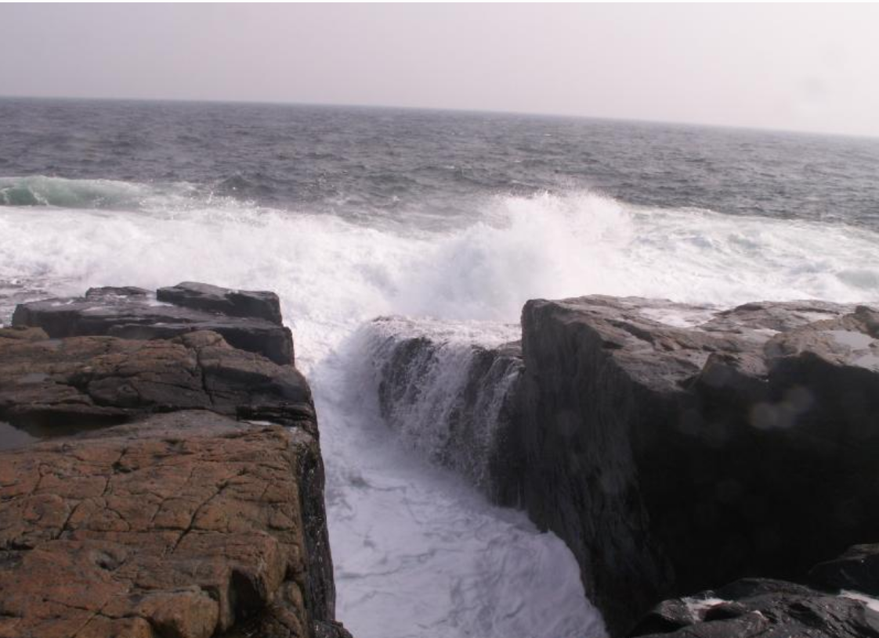
Notes:
The softer areas widen into slot-like inlets through which the waves slosh.

Slide 67
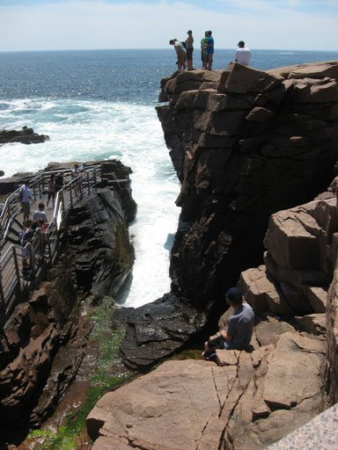
Notes:
The most famous of these is Thunder Hole,

Slide 68
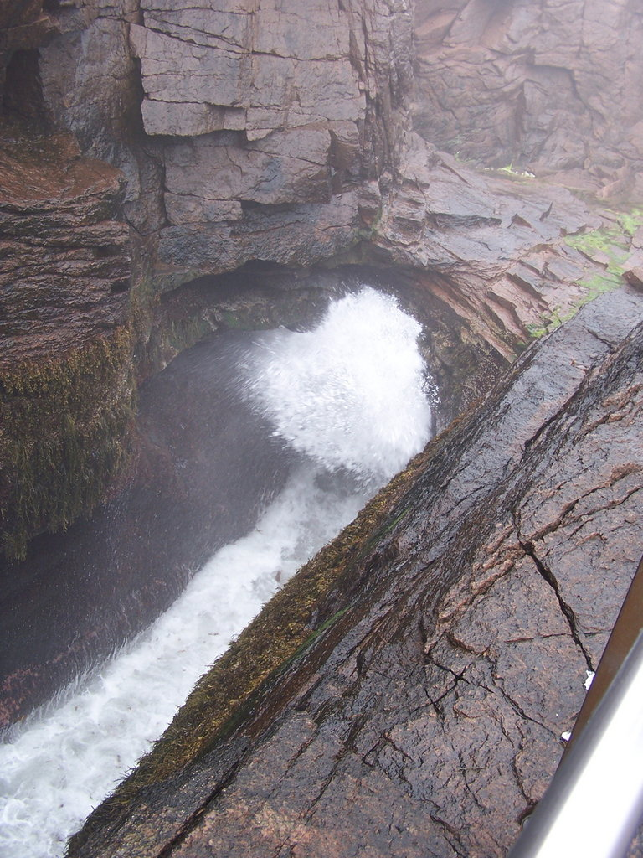
Notes:
… where, under the right tide and wave conditions, a thunderous booming sound can be heard as waves smack up against a small cave at the base of the eroded joint system here. More often, the hole produces an thrilling splash that equally delights park visitors.

Slide 69
Bye now.
I hope you enjoyed my story!
Notes:
…

Slide 70
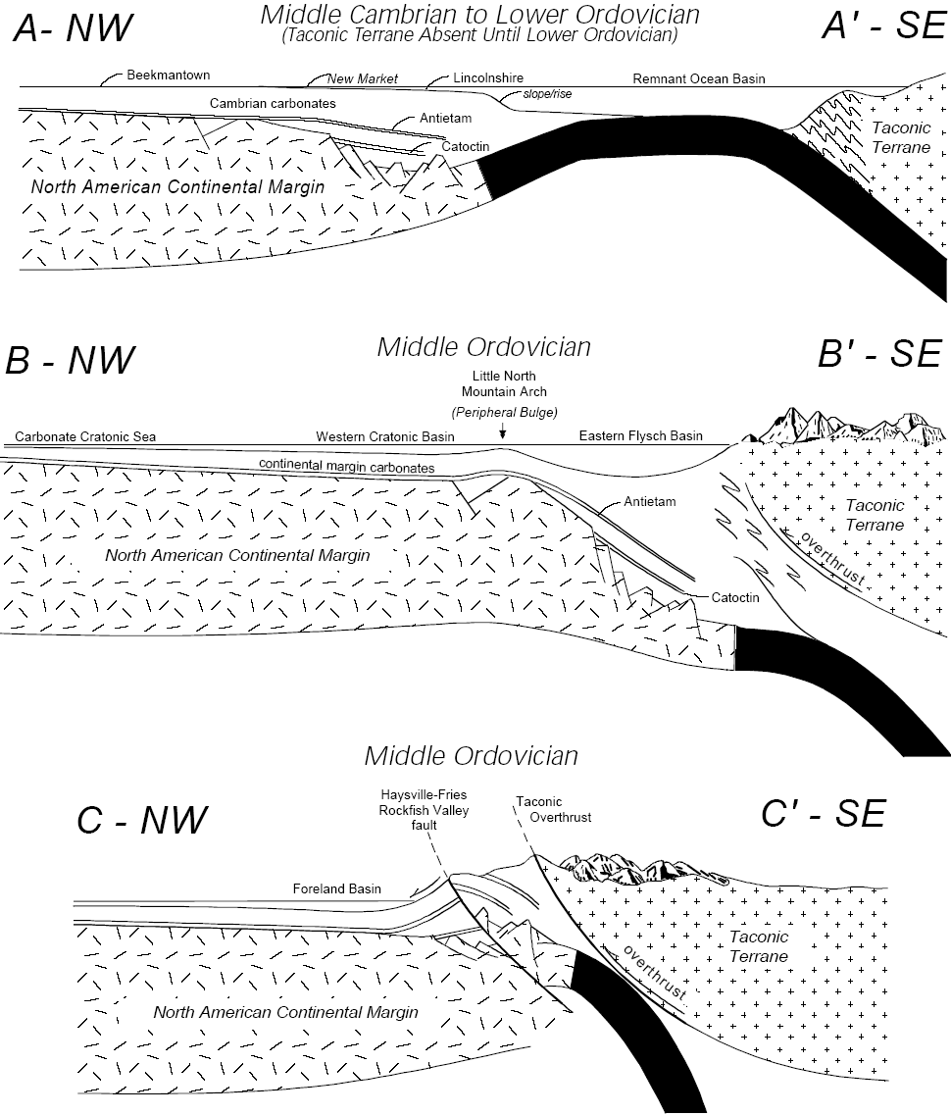

Slide 71
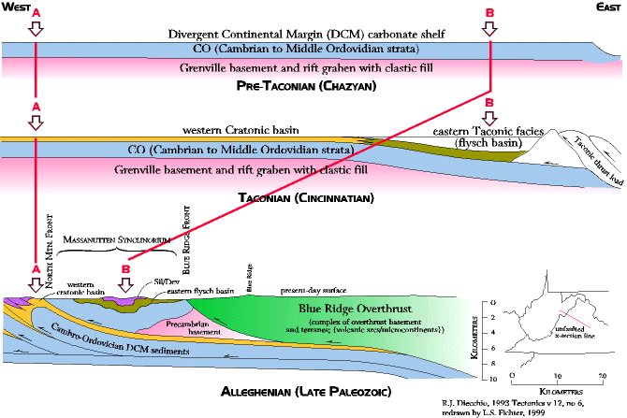
Notes:
Most of the time when we reconstruct geologic histories we used the present location of the rocks to make interpretations. That this is not always wise is shown by these cross sections. The present location of foreland basin rocks for the Taconic orogeny implies the basins are closer together than they were originally. But we can get some idea of their true original locations from these Interpretive Cross Sections. The first (Pre-Taconian) cross section shows the Virginia divergent continental margin stretched out with all the subsequent folding and faulting undone. The second cross section (Taconian) shows development of the Western Cratonic and Eastern Flysch basins in the Taconic. The third (Alleghenian) cross section shows the present location of all the rock units. Note the distance between reference arrows A and B. The third cross section (Alleghenian) shows how the rocks have telescoped together by folding and faulting. Note especially how the reference arrows A and B have moved close together, how the Eastern Flysch basin (dark green beds) has been thrust westward over top of the Western Cratonic rocks, and how most of the Western Cratonic basin rocks (yellow beds) extend far to the east below the surface.

Slide 72
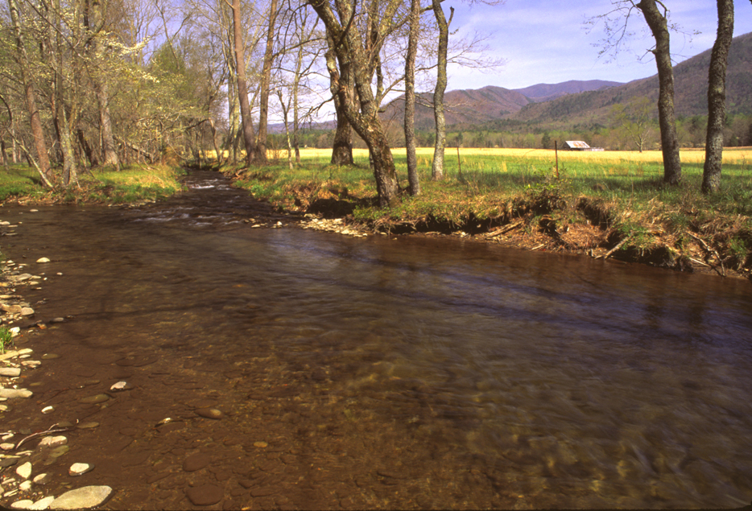
Notes:
Great Smoky Mtns 14 EGS.jpg Cades Cove, Sparkes Lane. (Photo by Edward G. Soldo)

Slide 73
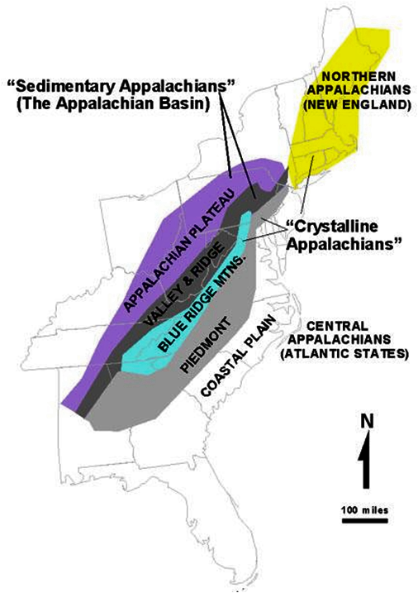

Slide 74
Geologic History of the Appalachian Mountains- Colliding and Rifting Continents
Precambrian
1. N. America, Africa, Asia and Europe collide to form a super continent METAMORPHISM
2. Super continent rifts apart forming proto-Atlantic Ocean (Iapetus)
FORM BASALTS
3. Tensional rifting forces change to compression and subduction BUILD ANDESITIC VOLCANIC CHAINS
Paleozoic
1. Taconic Orogeny- collision of andesitic volcanic chain with N. America DEFORMATION, METAMORPHISM, MAGMATISM
2. Acadian Orogeny- Avalon terrane collides with northern coast of N. America DEFORMATION, METAMORPHISM, MAGMATISM
3. Alleghenian Orogeny- all continents collide to form super continent called Pangea DEFORMATION, METAMORPHISM, MAGMATISM

Slide 75
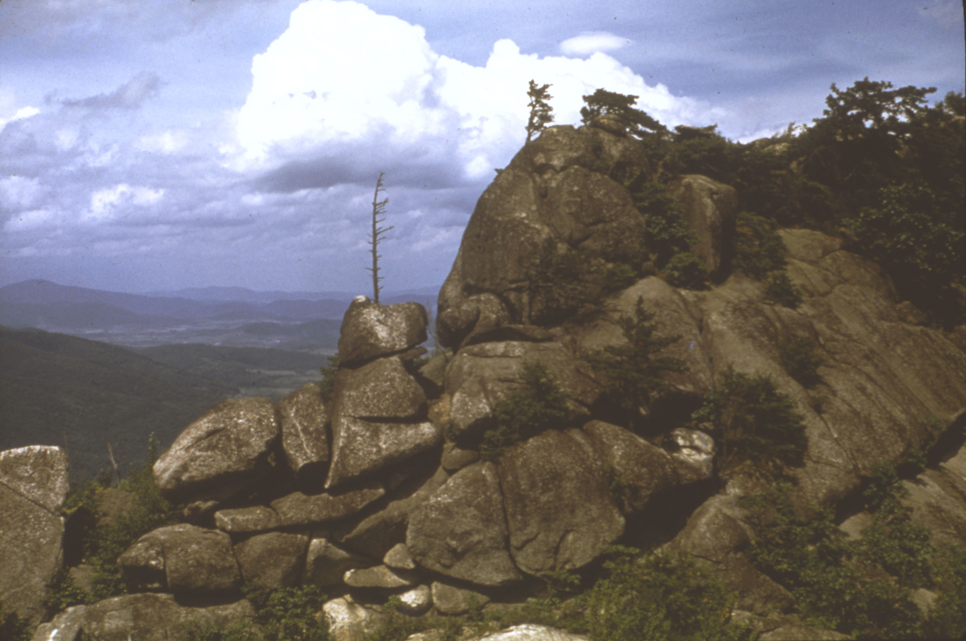
Old Rag Mountain – Precambrian Granite
Notes:
Shenandoah 02NPS.jpg Old Rag Mountain Top view. (National Park Service Photo)

Slide 76
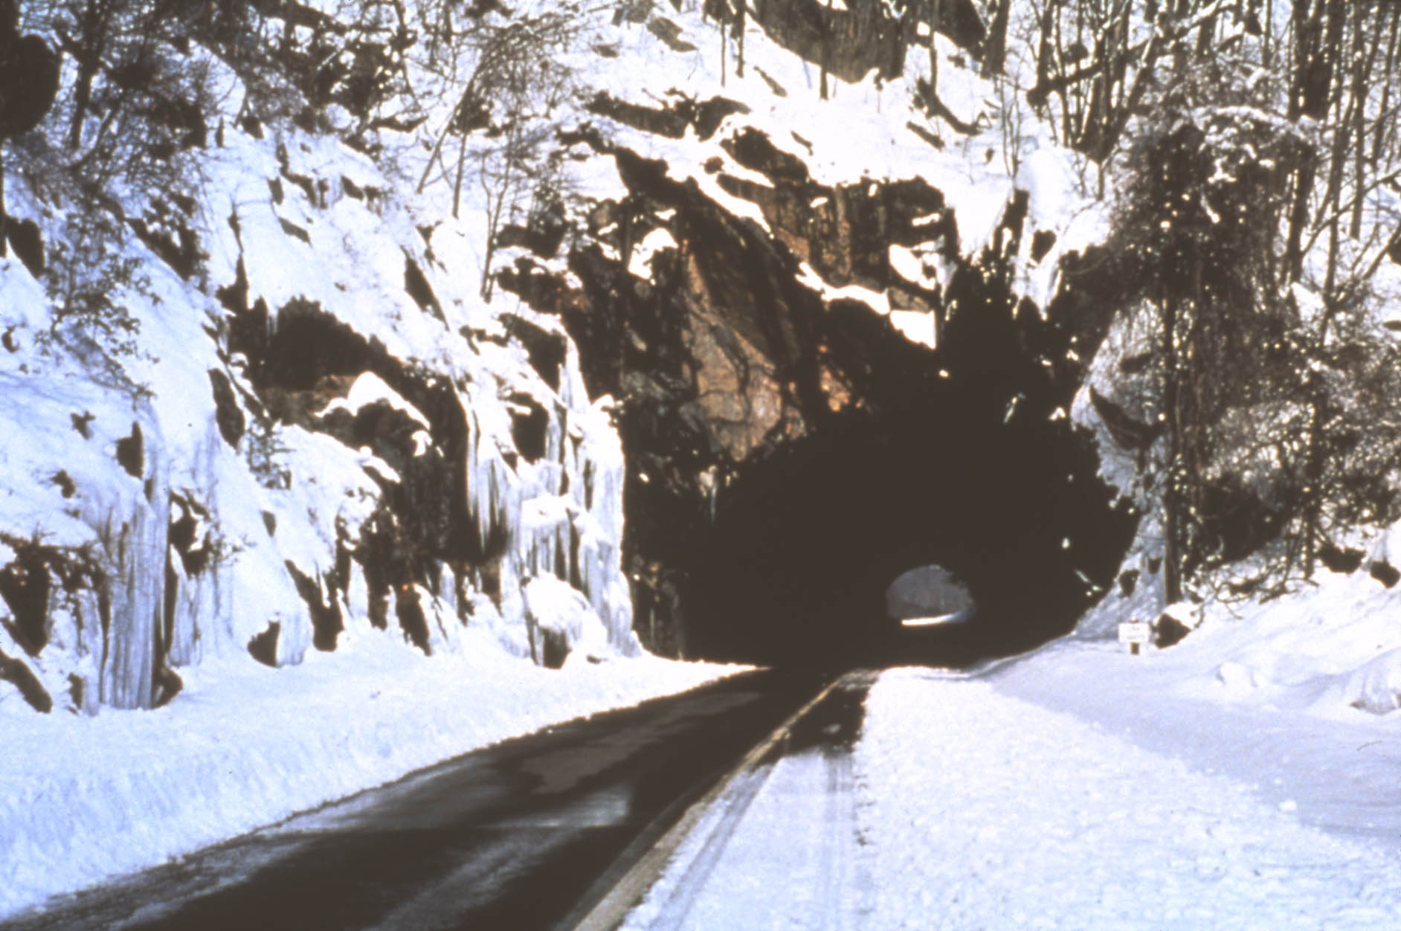
Mary’s Rock Tunnel – Granodiorite gneiss (Pedlar Formation)
Notes:
Shenandoah 04NPS.jpg Mary’s Rock tunnel. (National Park Service Photo)

Slide 77
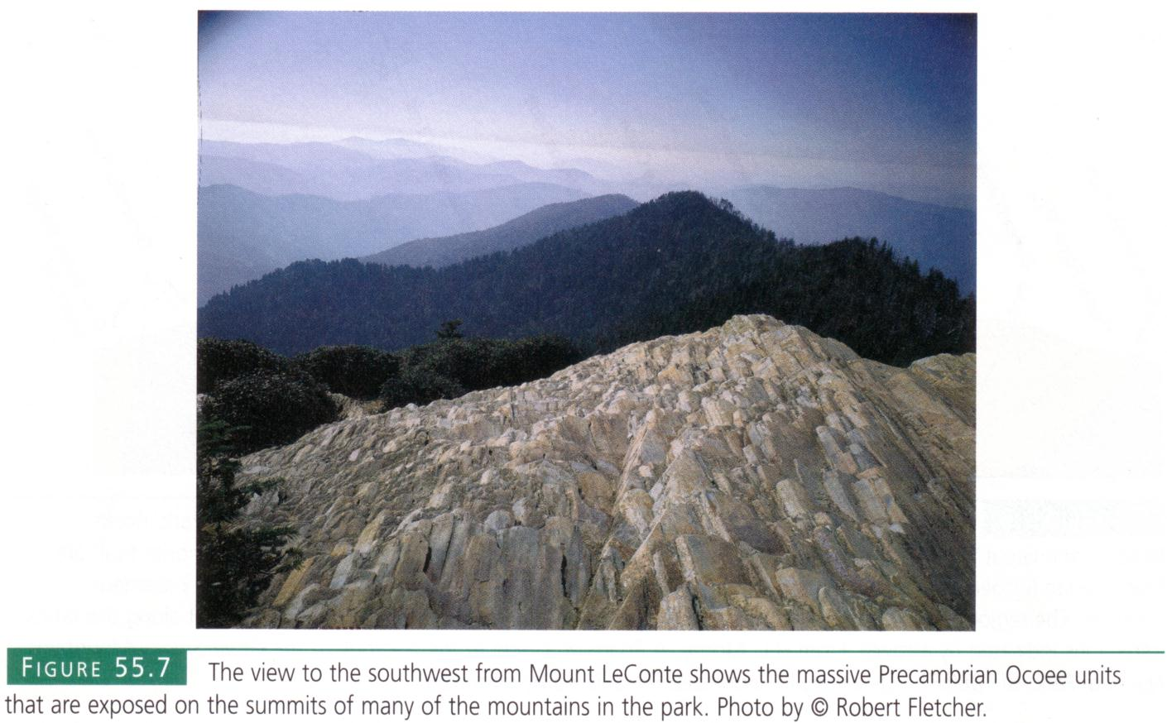

Slide 78
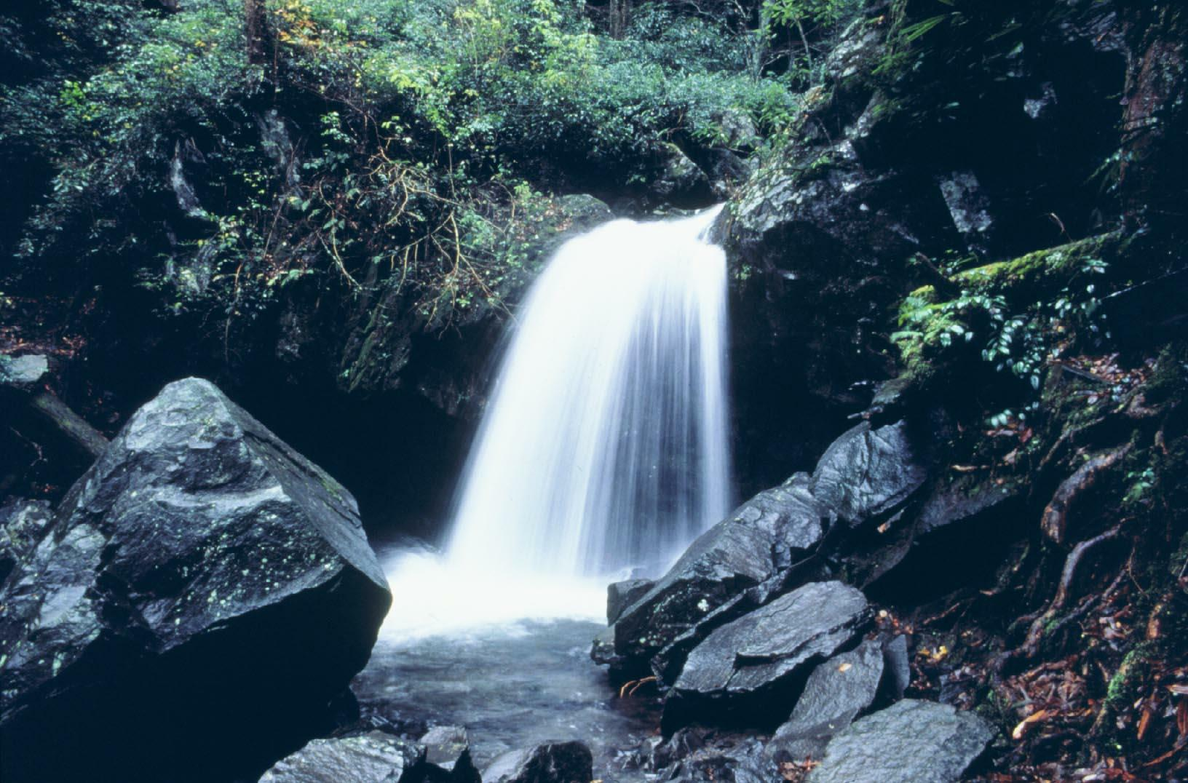
Notes:
Great Smoky Mtns - GrottoFalls2_3701 NPS.jpg (National Park Service Photo) Late Proterozoic Elkmont Sandstone that forms the base of the Great Smoky Group.

Slide 79
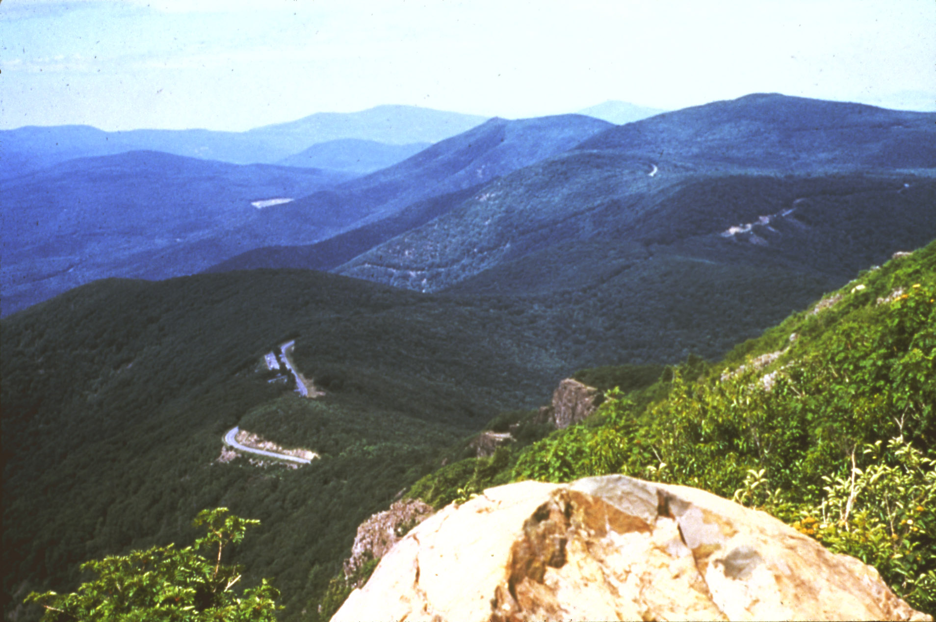
Stony Man Mountain – Another Catoctin lava flow.
Notes:
Shenandoah 06NPS.jpg View north from Stony Man Mountain. (National Park Service Photo) Geology: You're standing on top of the second Catoctin lava flow. The cliffs that rise above you are lava of the third flow. When enough time elapsed between eruptions, soil and sediments collected on top of the older lava. That's what happened here. As the molten lava of the third eruption advanced it churned up soil, sand, and mud. The rock that rises beside the trail here is worth close study. The greenstone contains red-brown lumps of ancient mud and soil, grains of sand, and some silvery schist that may have been formed from a layer of volcanic ash that fell before the lava flow. (The rocks are also dotted with white, green, and gray lichens.)

Slide 80
Notes:
When basaltic lava erupts onto the surface of the Earth, as it did during the extrusion of the Catoctin Formation, the lava loses heat quickly to the atmosphere. This loss of heat cools the lava down, and lets it solidify into igneous rock. As it cools, the basalt contracts in volume, for the reason that hot things are less dense than cold things. As it cools, it contracts equally across the surface of the flow, and forms columnar jointing. These examples are on the Limberlost Trail, south of Skyland. Columns are about one foot in diameter.

Slide 81
Notes:
The overall sequence of events in Shenandoah National Park, as illustrated by Gathright (1976). From top to bottom:
Extrusion of lava flows.

Slide 82
Notes:
Deposition of Weverton Formation conglomerates and sand.

Slide 83
Notes:
Deposition of Harpers Formation mud.

Slide 84
Notes:
Deposition of Antietam Formation barrier island sands.
Deposition of Tomstown Formation and other Cambrian/Ordovician carbonates (limestones).
Folding and faulting of all rock units during Alleghenian Orogeny.

Slide 88
Paleozoic Granite of Avalon Terrane
Notes:
The Paleozoic granite here… was once the magma chamber of a Avalonian volcano.

Slide 89
Mount Desert Island – Acadia N.P.

Slide 90
Cadillac Mountain
Notes:
Rocks of the Avalon terrain occur all over Acadia National Park, but one of the most spectacular places to see them is atop Cadillac Mountain – one of the highest points along the entire Atlantic coast.

Slide 92
Orogenic Calm in the Central Appalachian Basin Silurian and Early Devonian; 435 - 370 mya
Approaching Acadian Orogeny
Notes:
was once the magma chamber of a Avalonian volcano. Like the Arvonian arc that preceded it in the Taconic orogeny, the Avalon arc was active up until the time it collided with North America because the subduction zone was still tilted away from the continent.

Slide 93
Notes:
Cades Cove is a great example of a thrust window. Younger (Ordovician) DCM carbonates are exposed in the window

Slide 94
Cades Cove

